Slide 1
UNIT 6:
Multiple Baseline & Multiple Probe Designs

Slide 2

AGENDA
MULTIPLE BASELINE DESIGNS
MULTIPLE PROBE DESIGNS
UNIT 9 PROJECT

Slide 3

EARLY POSTERS:
Kevin
Kayla
Neil
Jessie
Bettina
Lury
Julie

Slide 4



MULTIPLE BASELINE DESIGNS
Across Participants
Across Settings
Across Behaviors

Slide 5
WHAT IS A MULTIPLE BASELINE DESIGN?
An experimental design that begins with the concurrent measurement of two or more behaviors in a baseline condition, followed by the application of the treatment variable to one of the behaviors while baseline conditions remain in effect for the other behavior(s). After maximum change has been noted in the first behavior, the treatment variable is applied in sequential fashion to each of the other behaviors in the design. Experimental control is demonstrated if each behavior shows similar changes, when and only when, the treatment variable is introduced. (Cooper, Heron & Heward 2007)

Slide 6
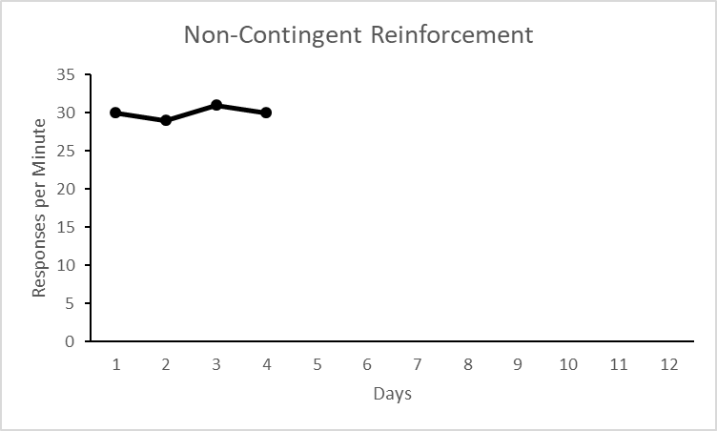
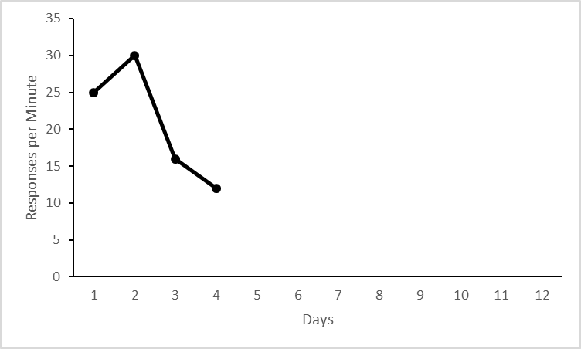
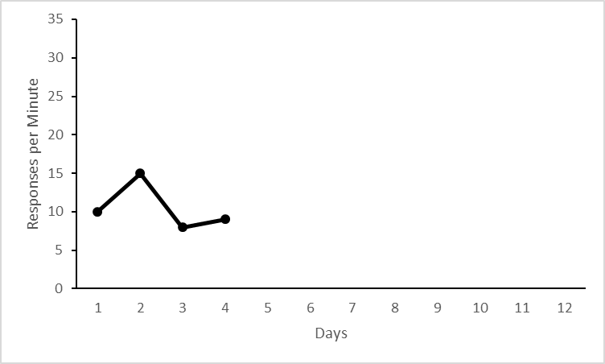
Begins with the concurrent measurement of two or more behaviors in a baseline condition
Target behavior is SIB
Alice
Betty
Carol

Slide 7
Followed by the application of the treatment variable to one of the behaviors while baseline conditions remain in effect for the other behavior(s)
Alice
Who should we start with?
Betty
Carol

Slide 8
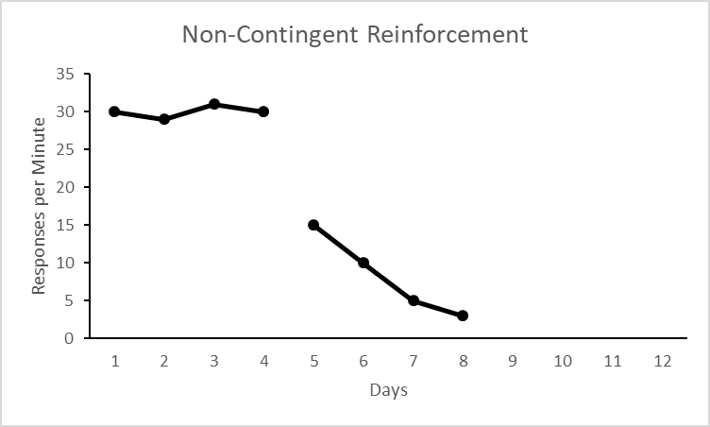
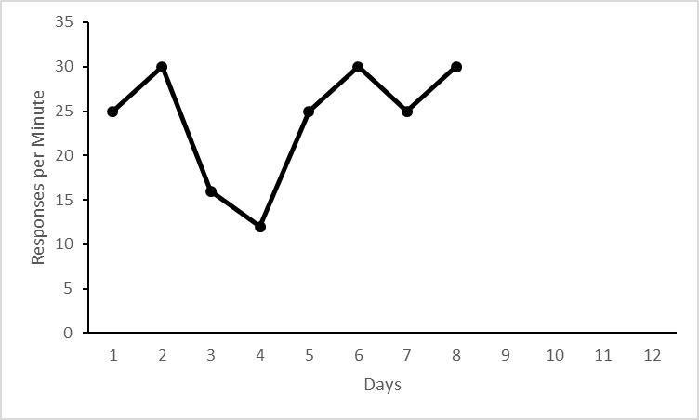
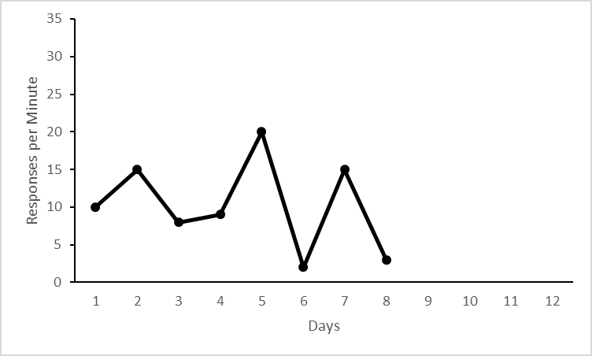
Followed by the application of the treatment variable to one of the behaviors while baseline conditions remain in effect for the other behavior(s)
B
What has happened to Alice’s SIB?
A
Alice
What about Betty and Carol?
A
Betty
A
Carol

Slide 9
After maximum change has been noted in the first behavior, the treatment variable is applied in sequential fashion to each of the other behaviors in the design
B
Who’s Next?
A
Alice
A
Betty
A
Carol

Slide 10
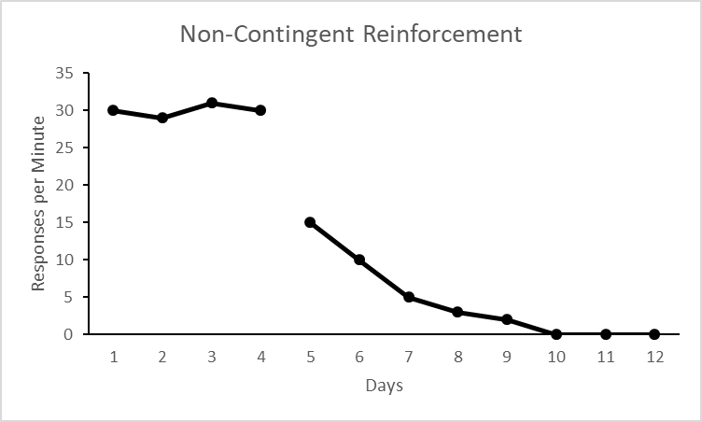
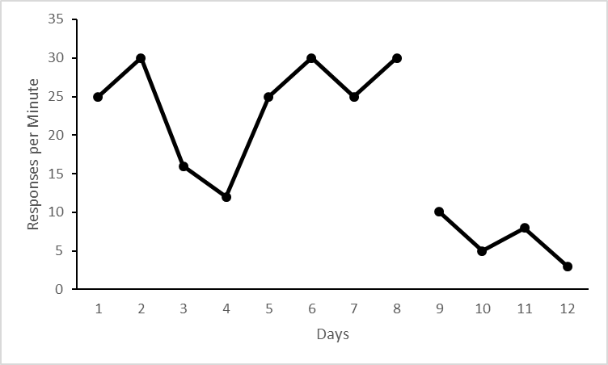
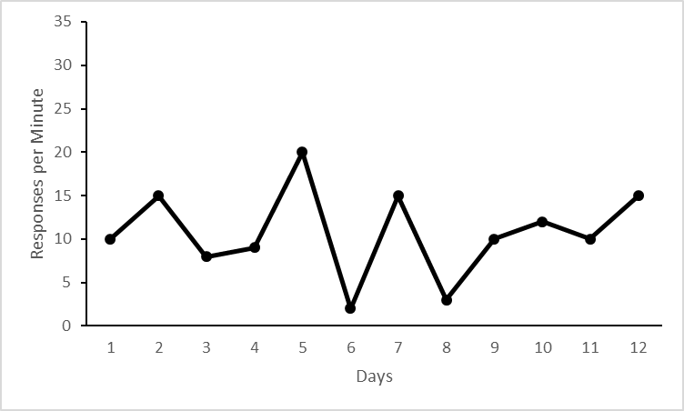
After maximum change has been noted in the first behavior, the treatment variable is applied in sequential fashion to each of the other behaviors in the design
B
What has happened to Betty’s SIB?
A
Alice
Betty
What about Carol’s?
A
B
A
Carol
Now what?

Slide 11
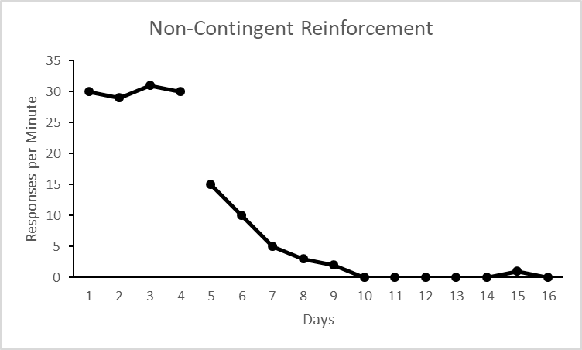
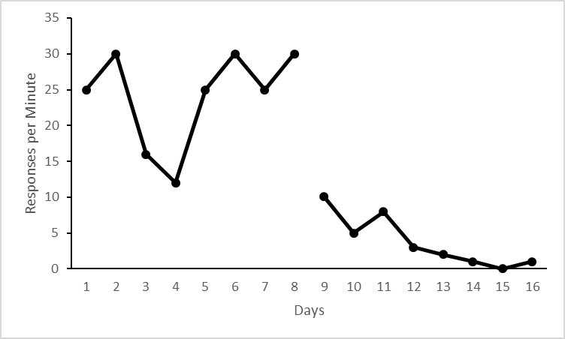
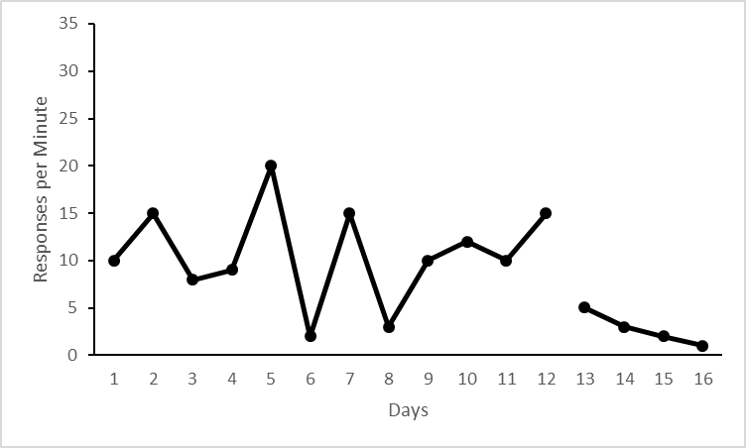
Do it again! It’s Carol’s turn!
B
A
Alice
Betty
Carol

Slide 12
Internal Validity
Demonstrated by immediate change in DV upon introduction of the IV
Delay in effect weakens internal validity
Inconsistent effects across participants weakens internal validity

Slide 13
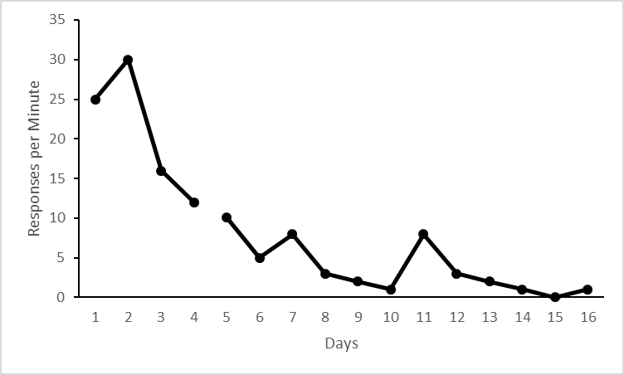
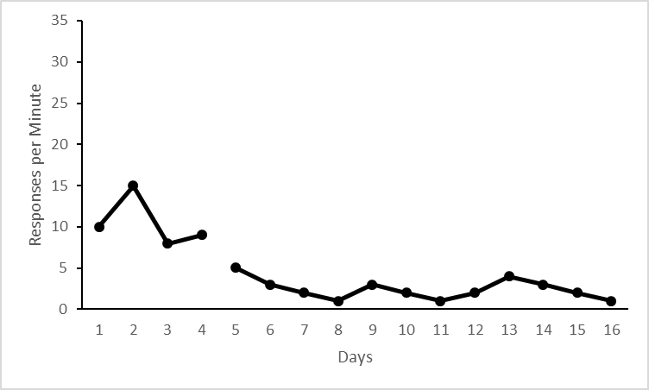
Is this just as good?
Alice
Betty
Carol

Slide 14
Multiple Baseline Across Settings
B
Mom’s House
A
Dad’s House
School

Slide 15
Internal Validity
Need to collect “acceptable BL data in each setting”
Behavioral covariation – target bx will function independently across stimulus conditions.
Inconsistent effects – stimulus control must be similar to permit replication each time IV is applied

Slide 16
Multiple Baseline Across Behaviors
DRO
B
Aggression
A
Property Destruction
SIBB

Slide 17
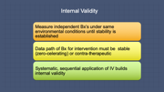
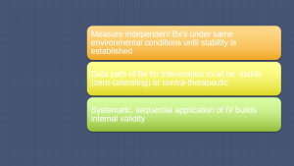
Internal Validity
Measure independent Bx’s under same environmental conditions until stability is established
Data path of Bx for intervention must be stable (zero-celerating) or contra-therapeutic
Systematic, sequential application of IV builds internal validity

Slide 18

The Nuts and Bolts of MB Designs
Identify
Identify 3 or more tiers (behaviors, people or settings) that are functionally independent but functionally similar
Determine
Determine a criterion for staggering the IV
Monitor
Continuously monitor all tiers
Introduce
Introduce IV to one tier at a time

Slide 19
The Good, The Bad, and The Ugly
ADVANTAGES
DISADVANTAGES
Intervention does not have to be withdrawn
Works for irreversible behaviors
Allows for intrasubject replication
Requires the identification and measurement of several tiers
May be time consuming
Prolonged baselines may be unethical

Slide 20

Multiple Probe Designs

Slide 21
Multiple Probe Design
A variation of the multiple baseline design that features intermittent measures, or probes, during baseline
It is used to evaluate the effects of instruction on skill sequences in which it is unlikely that the person can improve on later steps in the sequence before learning prior steps

Slide 22

Multiple Probe Design – Key Features
An initial probe is taken to determine level of performance on each behavior in the sequence.
1
A series of baseline measures is obtained on each step prior to training on that step
2
After criterion-level performance is reached on any training step, a probe of each step in the sequence is obtained to determine whether performance changes have occurred.
3

Slide 23
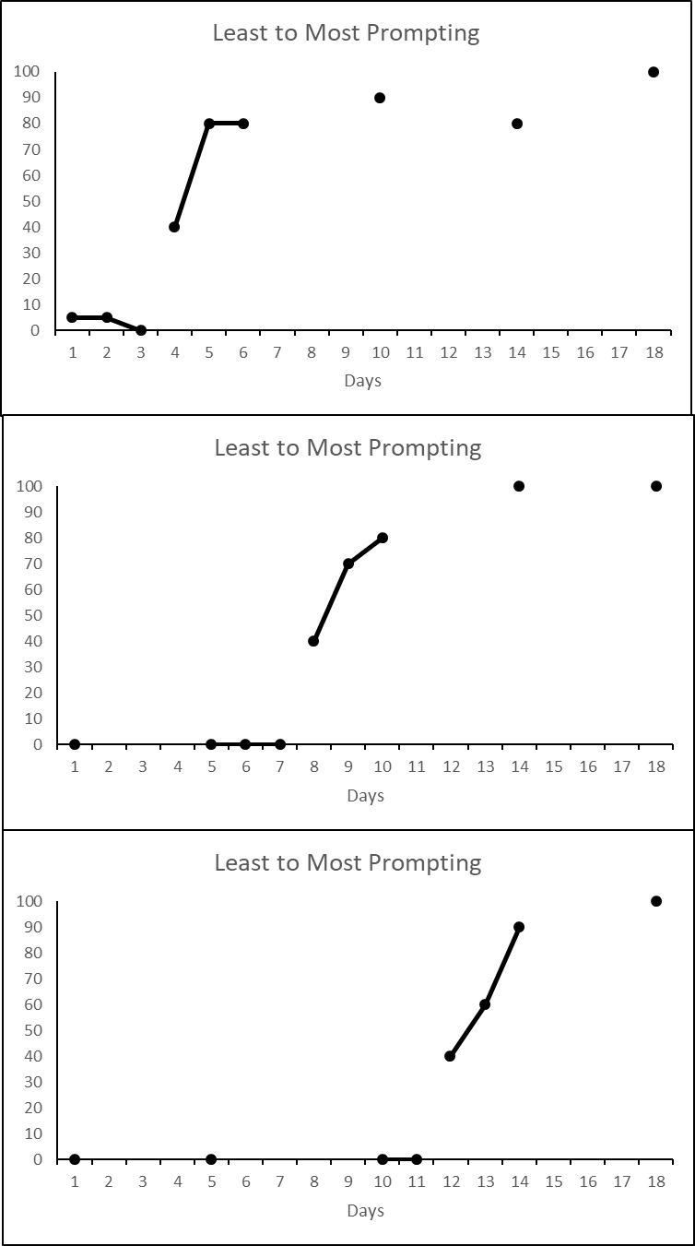
Multiple Probe Design - Example

Slide 24
Non-Concurrent (Delayed) Multiple Baseline Design
A group of AB designs with varying (usually predetermined) amounts of time spent in the A (Baseline) Condition
Baselines are not measured at the same time
It allows the use of fewer resources and the researcher may extend the study to new behaviors, settings, and individuals. Allows for more flexibility.

Slide 25
Non-Concurrent Multiple Baseline Design - Example
Year 1 - Collect BL only in Setting 1; implement IV following stable baseline
Year 2 - Collect BL only in Setting 2; implement IV following stability and longer BL than Setting 1 as determined or stable).
Year 3 - Collect BL only in Setting 3; implement IV following stability and longer BL than Setting 2

Slide 26
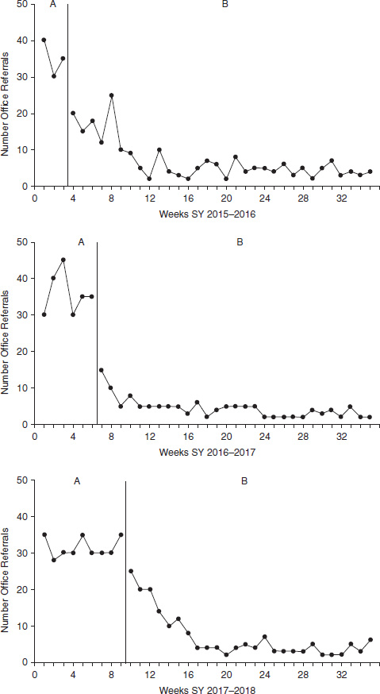
Example graph from
Gast, Lloyd, & Ledford (2018)
2015 – 2016 School Year
Baseline length varies
2016 – 2017 School Year
2017 – 2018 School Year

Slide 27

UNIT 9 PROJECT

Slide 28
Introduction
1 paragraph on general topic (the target behavior, the intervention)
Literature review of at least 3 research articles
2 paragraphs each to include
    • A brief description of the research question(s) and hypothesis
    • The method, setting, and subjects, research design
    • A summary of the results
    • The conclusions as reported by the study author(s)
    Rationale for your study
    Thesis statement

Slide 29
General Topic
General discussion of the target behavior and intervention you will study.
Avoidant/restrictive food intake disorder (ARFID), a relatively new feeding disorder diagnosis in the Diagnostic and Statistical Manual of Mental Disorders, 5th ed. (DSM-5; American Psychiatric Association 2013), is provided to patients who struggle with impaired and distressing eating behaviors and symptoms yet lack the weight and body image-related concerns associated with anorexia nervosa and bulimia nervosa. Among patients with ARFID, the consumption of foods is limited based on the food’s appearance, smell, brand, presentation, previous negative experiences with the food, and/or fear of choking or vomiting. Children with ARFID can have different etiologies, including but not limited to delayed oral-motor skills, failure to master self-feeding skills, history of selective (picky) eating, disruptive mealtime behavior, rigid food preferences, and/or fear of vomiting (Fisher et al. 2014; Norris et al. 2014). ARFID is directly linked to a variety of short- and long-term health consequences including growth retardation, malnutrition, developmental and psychological deficits, poor academic achievement, social difficulties, invasive medical procedures (e.g., placement of a feeding tube), or death (Kodak & Piazza 2008; Sharp et al. 2010).

Slide 30
General Topic
ARFID Treatment
Patients with ARFID have varied presentations, histories, and risk factors, making referrals to the most appropriate healthcare professionals or facilities challenging. Depending on which factors are thought to be driving the eating disturbances, patients’ needs differ. Few hospitals or healthcare facilities have specialized clinics to treat ARFID; thus, assessment and treatment often requires collaboration among numerous healthcare providers in various locations.
Empirically validated treatments for ARFID have not yet been established (Norris et al. 2016); however, behavioral interventions have well-documented empirical support and a strong evidence base in the scientific literature for the treatment of pediatric feeding disorders (Sharp et al. 2010). For instance, operant procedures, including physical guidance of appropriate feeding responses, differential reinforcement (DRA) contingent upon appropriate eating behaviors, and shaping, have been identified as effective interventions (Hodges et al. 2017), and several studies have demonstrated the effectiveness of a systematic hierarchical sequence using differential reinforcement contingent upon demonstrating desired behaviors to increase food acceptability (Hodges et al. 2017). In the case of feeding interventions, the desired behavior is typically amount/bites/volume consumed, increased variety of foods, and/or appropriate mealtime behavior.

Slide 31
Literature Review
Problem
Feeding treatment often involves numerous office visits. Even to complete the initial intake, several appointments with the dietitian, speech therapist, psychologist, and/or additional feeding clinic member(s) may be required. Although children typically eat in the home setting, feeding assessment and treatment typically occurs in behavioral health clinics and specialty inpatient programs (Milnes & Piazza, 2014) and rarely in the home (Najdowski et al. 2003). To improve generalization to the home environment, telehealth is a desirable mode of delivery for feeding assessment and therapy to allow for naturalistic observations within the home environment, including parent-child interactions that may contribute to feeding problems (Silverman 2010). Telehealth is defined as the delivery of virtual health-related services from one site to another via information and communication technologies (e.g., video, remote patient monitoring, or mHealth mobile applications). Telehealth is a modality of treatment rather than a specific type of treatment. Guidelines for telehealth treatment delivery exist in the USA and Canada (e.g., APA 2013; American Telemedicine Association 2013; Consortium of Telehealth Resource Centers 2015).
Proposed solution

Slide 32
Literature Review
In regard to feeding treatment, teleconsultation has been considered “probably useful” for the initial clinical interview and “likely to be useful” for behavioral management and parent training sessions (Silverman 2010). Positive outcomes have been demonstrated with the use of videoconferencing to deliver treatment for children and adolescents with chronic illnesses (Van Allen et al. 2011) and depression (Nelson et al. 2006). Additionally, an 8-week parenting intervention using teleconsultation for families of children with ADHD improved children’s behavior while decreasing parental distress (Reese et al. 2012). Parents of children who participate in interventions via teleconsultation generally report high levels of treatment satisfaction (Hall & Bierman 2015). While a recent investigation of a family-based treatment for anorexia nervosa delivered via telehealth indicates satisfactory clinical outcomes (Anderson et al. 2017), no known investigations exist on the use of teleconsultation to deliver feeding treatment to children with ARFID.
Relevant studies

Slide 33
Rationale and Thesis Statement
This study aimed to contribute to the research on parent teleconsultation telehealth applications of parent-implemented behavioral strategies by implementing a stepwise changing contingency for reinforcement procedure for a child with ARFID. The treatment presented in this study was developed to address treatment needs for children with ARFID and extends the work of Fisher et al. (2014). Research questions and hypotheses were as follows:
Is there a functional relationship between an intervention identified by parent teleconsultation (i.e., a stepwise changing contingency for reinforcement) and the increase in the level of bites of nonpreferred foods consumed?
To what extent can a parent implement a behavioral feeding intervention taught over teleconsultation with high treatment integrity as measured by 80% or greater fidelity on a treatment integrity checklist? It is hypothesized that a parent will complete intervention procedures with high levels of treatment integrity.

Slide 34
Reference
Bloomfield, B. S., Fischer, A. J., Clark, R. R., & Dove, M. B. (2019). Treatment of Food Selectivity in a Child with Avoidant/Restrictive Food Intake Disorder Through Parent Teleconsultation, Behavior Analysis in Practice (12) 33–43.

